Slide 1
CAPSTONE PROJECT
BOOK CONNECT
BY AVIWE KOLI

Slide 2
USER EXPERIENCE TO ACHIEVE:
As a user, I want to view a list of book previews, by title and author, so that I can discover new books to read.
As a user, I want an image associated with all book previews so that I can recognize a book by the cover even if I forgot the name.
As a user, I want to have the option of reading a summary of the book so that I can decide whether I want to read it.
As a user, I want to have the option of seeing the date that a book was published so that I can determine how easy it is to obtain second-hand.
As a user, I want to find books based on specific text phrases so that I don’t need to remember the entire title of a book.
As a user, I want to filter books by author so that I can find books to read by authors that I enjoy.
As a user, I want to filter books by genre so that I can find books to read in genres that I enjoy.
As a user, I want to toggle between dark and light modes so that I can use the app comfortably at night.

Slide 3
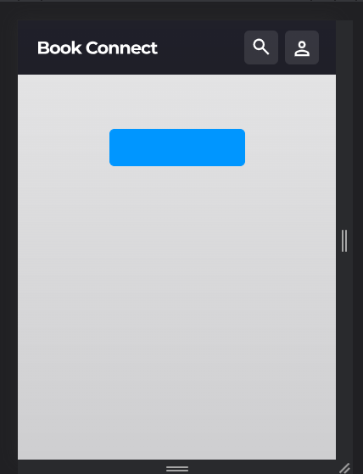
Challenges:
From the script code I forked from gitHub, these are the challenges I came across:
No books were being rendered on the initial (first) page of the application.
Even after rendering the books, the active functionality was not working.
Show more button was not working properly, which basically allows the user to load more books to load more books.
Search button was not working, which allows the user the previlege to filter the books they are interested in.
Settings button was not working, which allows the user to toggle between light and dark mode.

Slide 4
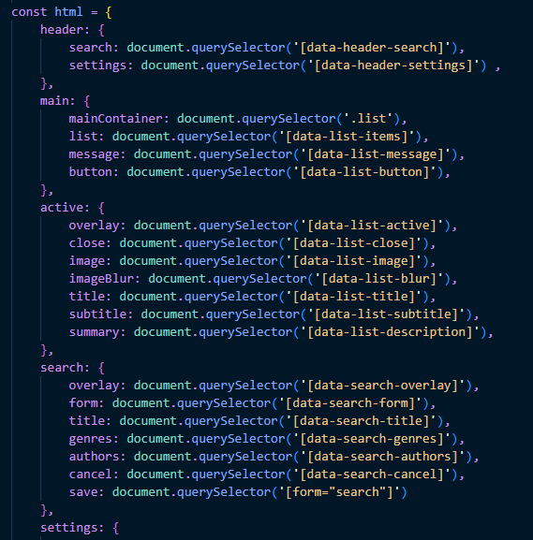
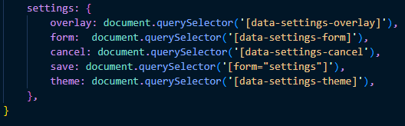
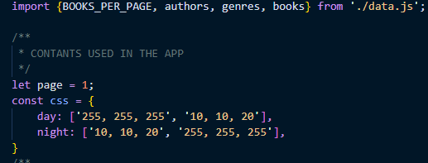
PROJECT PROPS

Slide 5
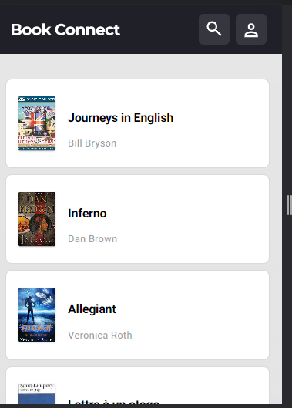
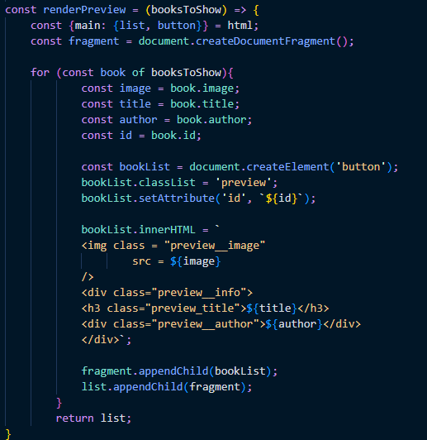
Initial Rendering of the page:

Slide 6
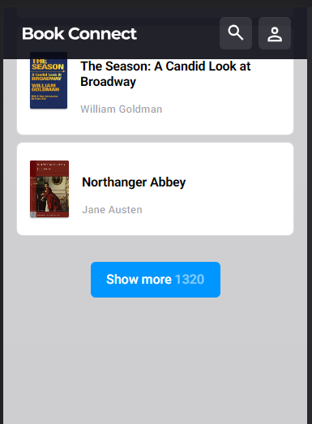
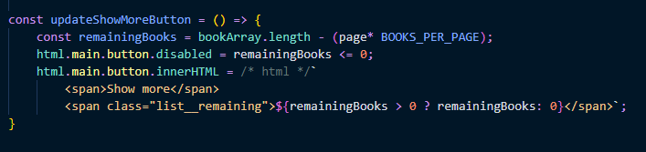
Show More Button:
The show more button allows the user to render or load more book into the page and display the number of books remaining

Slide 7
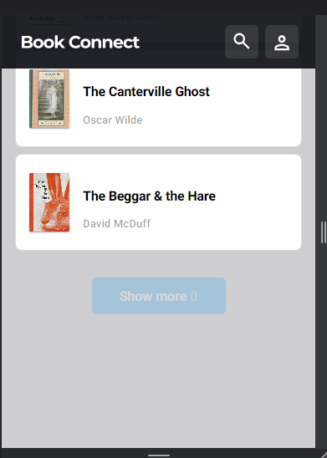
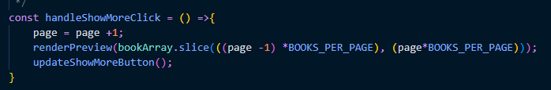
After loading all books:
When all the books have been loaded, the button is disabled

Slide 8
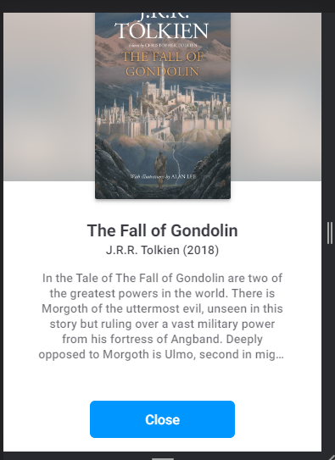
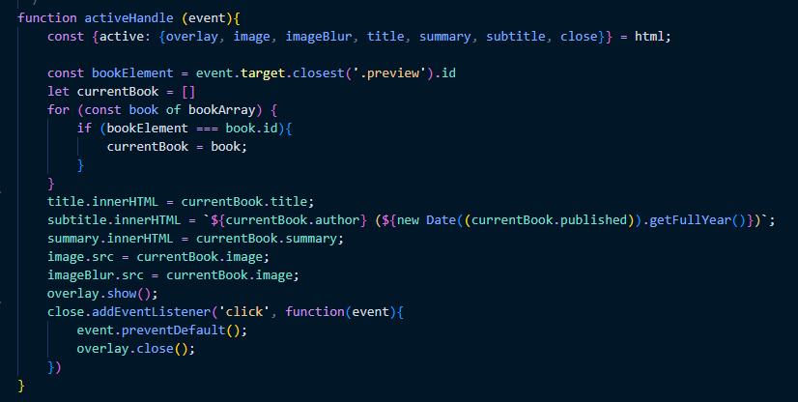
Book Preview:
A book preview which displays the book details:

Slide 9
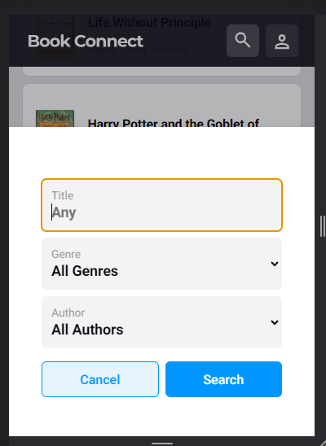
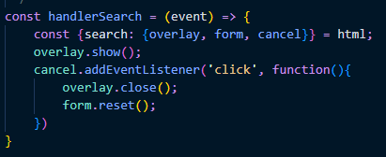
Book filter/ Search:
A dialog pop-up or overlay that display when the search button is clicked

Slide 10
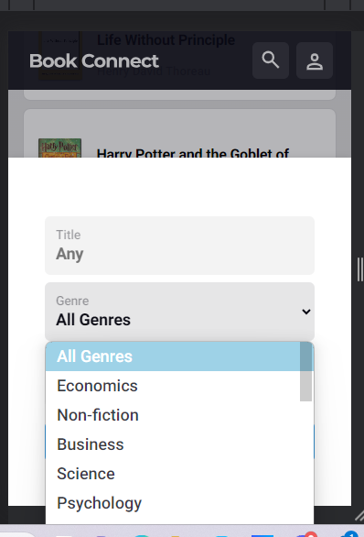
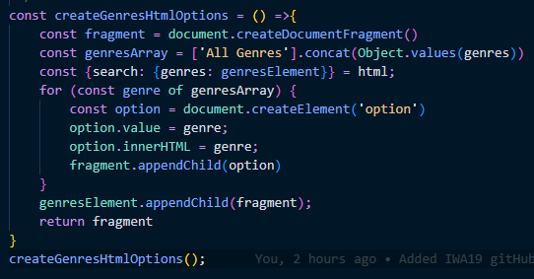
Genres Options:
Function that populates the DOM with genre options

Slide 11
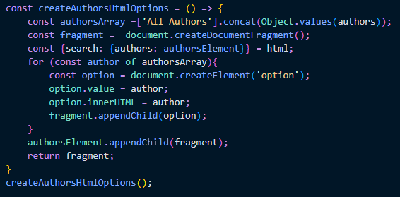
Author options:
A code snipped that populates the DOM with Author Options

Slide 12
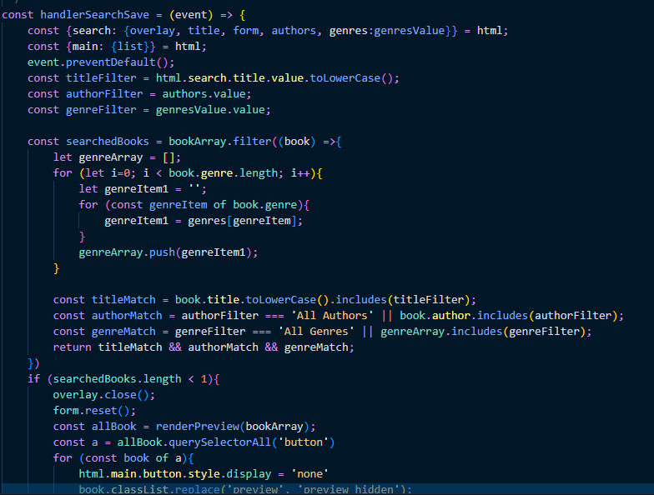
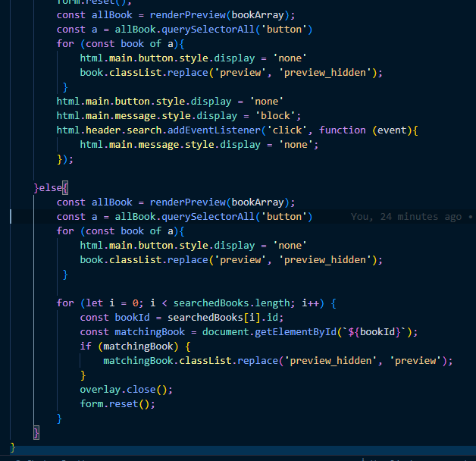
Search submit:

Slide 13
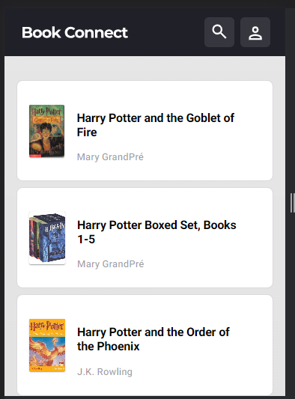
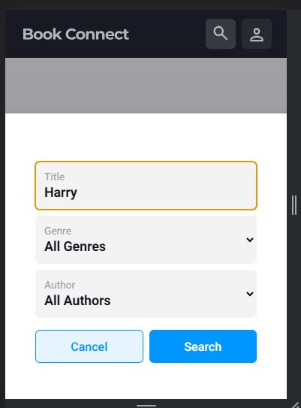
Search Example:

Slide 14
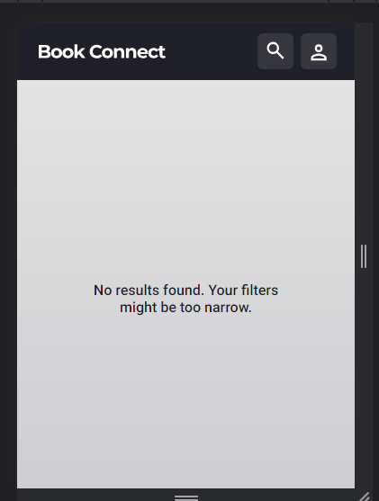
Search Example Part2
This shows what happens when no matches are found:

Slide 15
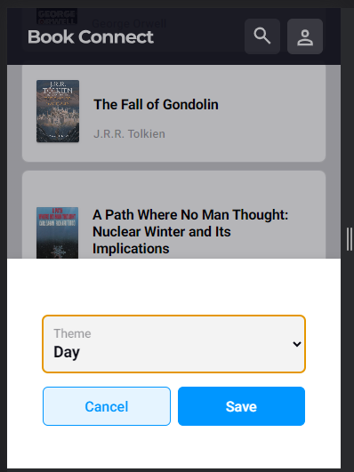
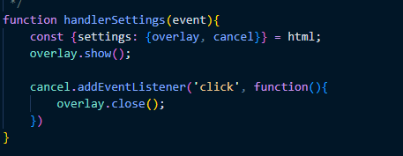
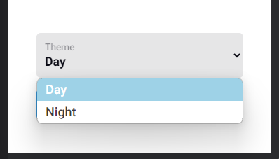
Theme Settings:
The dialog overlay that pops up that allows the user to toggle between
Dark and light mode settings.

Slide 16
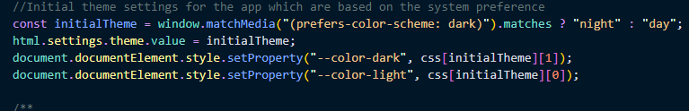
Theme to match system preference:
A code snipped checks the systems setting theme settings and apply them to the book connect application.

Slide 17
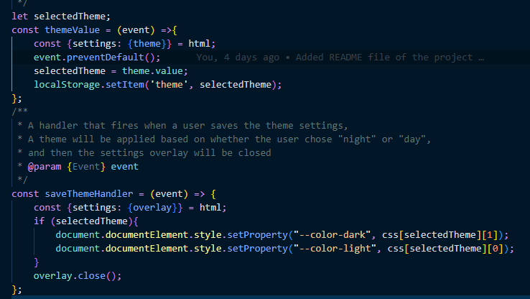
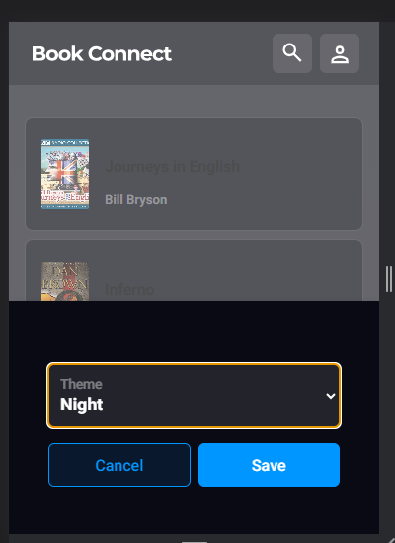
Applying theme Settings:
A code snipped of the function that applies a theme chosen by the user

Slide 18
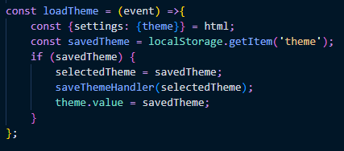
Theme Local Storage:
The function allows the application to be able to remembers the theme settings if for whatever reason, the user refreshes the page:

Slide 19
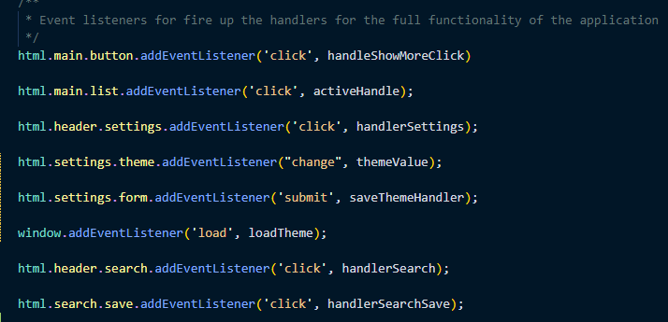
Event Listeners of the application
Below is a list of event listeners used to add functionality to the application.

Slide 20
THANK YOU!

